Slide 1
Flood monitoring and early warning system:
One of the most frequently occurring calamities around the world is a flood. For flood prone areas or countries, an essential part of their governance is flood management. The necessity to continuously review and analyze the adverse or ambient environmental conditions in real time demands developing a monitoring system so that floods could be detected beforehand.

Slide 2
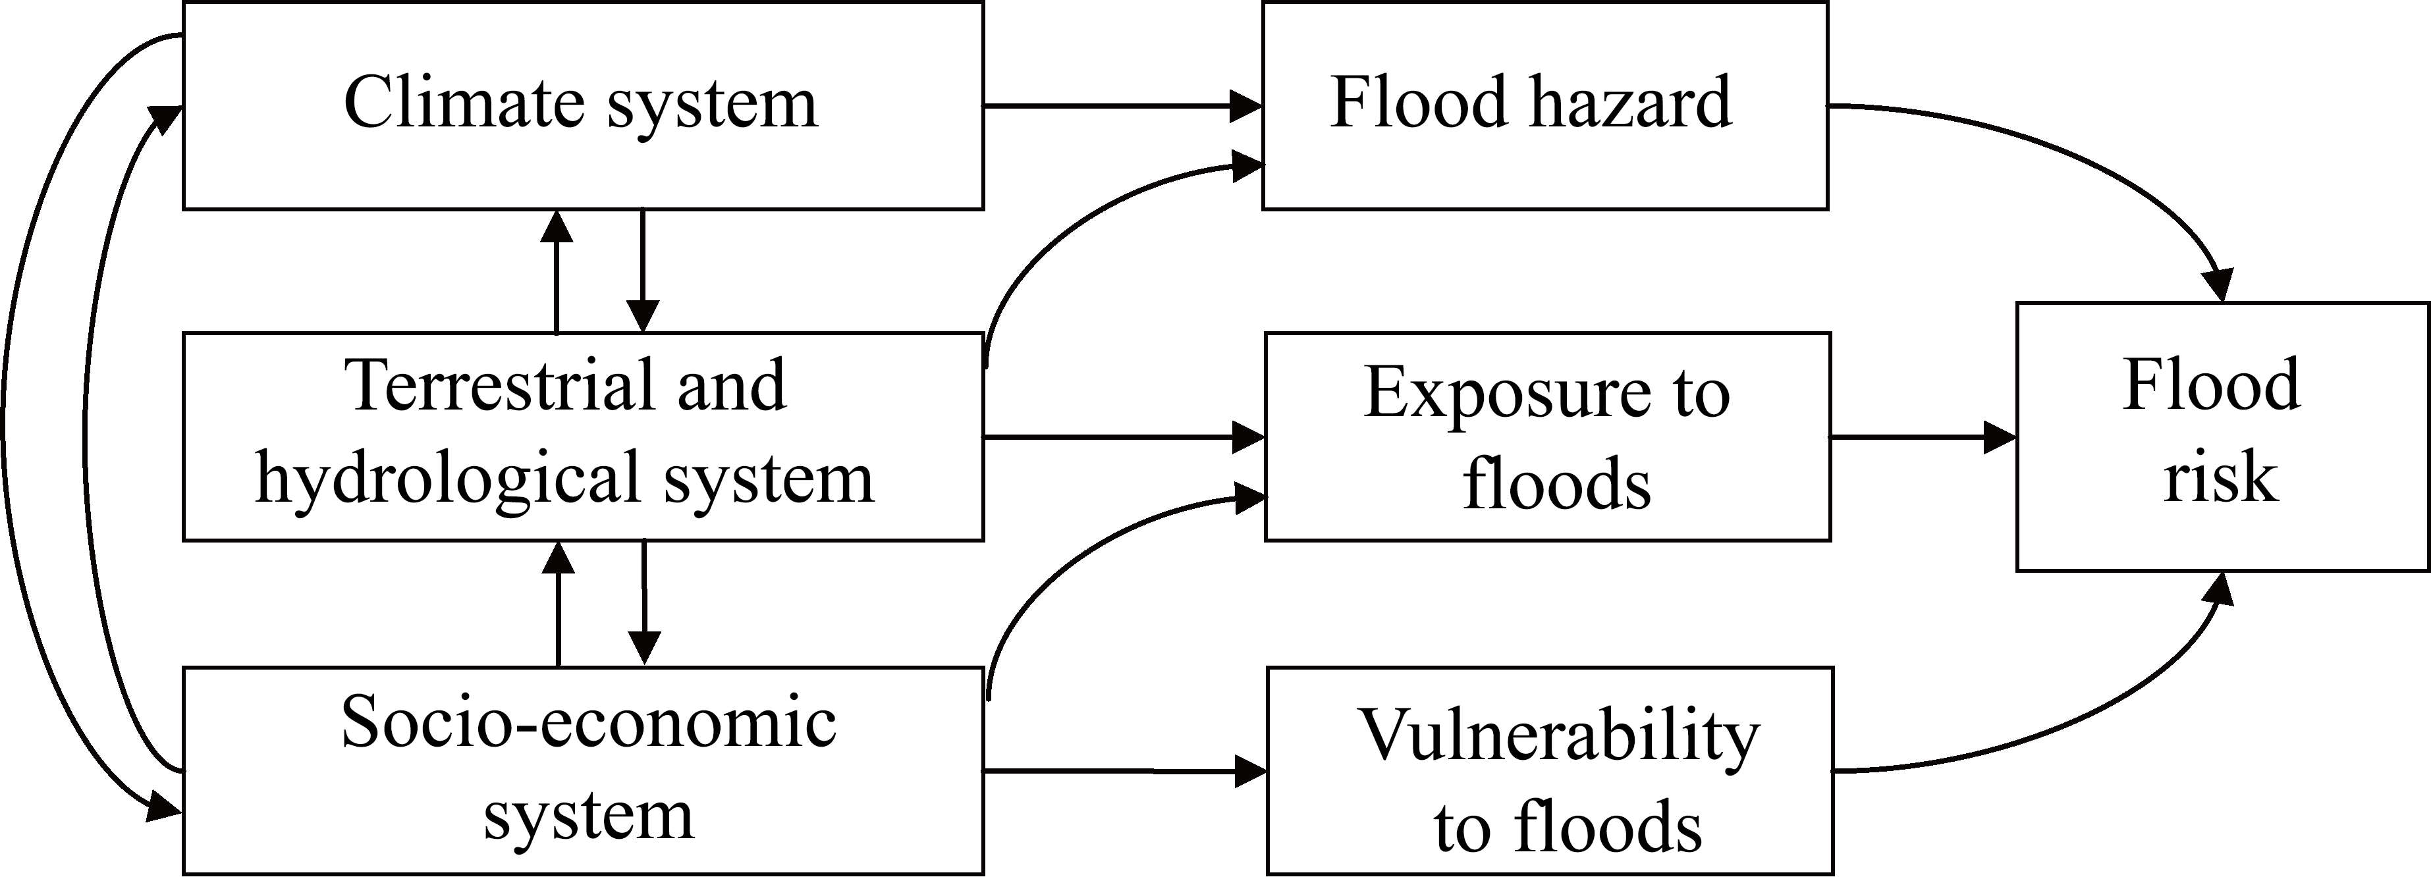
This Photo by Unknown Author is licensed under CC BY

Slide 3
Weather systems not always are quick or accurate enough to predict floods in time to prevent personal or environmental damages. The flood monitoring and warning system developed by ENVIRAIoT receives accurate and reliable information about real risks,so measures to protect the most vulnerable areas can be established and Public Administrations can collect real data to generate statistics for the design of optimal protection strategies.

Slide 4
The composition of the flood warning system
The warning system includes:
Wireless sensor network capturing relevant variables about the flow of rivers and streams
2) A smart computer system for the exploitation of hydrometerological and weather data captured to generate warnings and notifications for events that may involve a flood risk situation

Slide 5
Real time monitoring
ENVIRA IoT’s system controls the flow and its behaviour in real time,detects possible water courses and alerts about the flood risk with real and accurate data. It includes autonomous stations located at strategic points, equipped with a datalogger that reads the data captured by the sensors. Besides the sensors for the level of water courses,sensors for temperature and humidity,turbidity, water speed,capacity, etc…. can be installed.

Slide 6
Data display and analysis:
The IoT Envira DS platform enables the reception, organization and exploitation of data, reporting changes in levels, flows and speed. If the emergency center receives a warning, they will be able to connect immediately and see the situation of watercourses. Besides, although the data are sent to the center at planned intervals, it is possible to determine from the beginning the interval of time at which the platform will collect values unless there is a warning in that case the communication would be immediate.

Slide 7
Warning systems:
Acquisition and communication electronics continuously control the level of water and the delivery of data to the control center at planned intervals.
If a preset level or flow is surpassed, it generates data communication through SMS or e-mails to the authorized users.
The solution can be integrated with the early flood warning systems (EFWS) of Public Administrations.

Slide 8
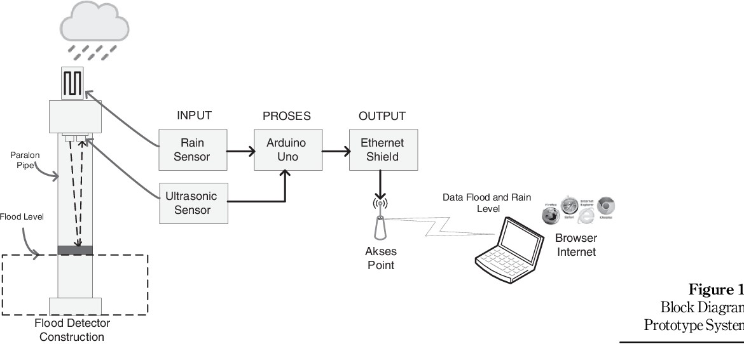

Slide 9
IoT- Based Flood information Monitoring system:
This was based on IoT which helps users to identify flood activity by reviewing weather conditions and inundation levels. The ultrasonic sensor HC-SR04 and another type of rain sensor were used to gather information related to flood altitude. It uses an Arduino Uno microcontroller to generate web-based data. The wireless router, TL-MR3020 is connected to the controller and linked with the gathered data and is shared with the users. This system was developed to address the situation of floods in Indonesia. The Ultrasonic and rain sensors are part of the input section whereas, the Arduino Uno Microcontroller is part of the process. An IoT-based flood information monitoring system is shown in the above diagram

Slide 10
The Ethernet shields and the wireless access points constitute the output section which is well integrated. Both sensors are placed upper side of the system with a cork float inside which will reflect an echo signal which sensor acknowledges through its trigger. The rain sensors will detect rain conditions and the water height is checked in the pipe. The Arduino Uno Microcontroller receives the data from sensors that are served in the web server. The early warning system is a web-based system that users can access which includes web flood information.

Slide 11
IoT, big data, and HPC based smart flood management framework:
To implement this system, a number of IoT devices were installed in classified geographical regions. In this framework, the flood related data consisting of attributes that are gathered by these IoT devices are processed by using High Performance Computing(HPC) and Big-Data. The attribute reduction is carried out by using singular value decomposition, the flood situation is identified using K-mean clustering algorithms and the predictions for the future are done using Holt-Winter’s method.

Slide 12
Advantages:
Timely detection of possible flood risks and floods
Tailored solution that can be integrated with external developments at any level(device,connectivity,cloud or user application).
Creation of historic data for Administrations.
An unlimited number of devices can be included in future extensions.
Long working life of the equipment.
Highly reliable and available real time data
Total adaptation and integration with emergency plans.
Low energy consumption.
Far-reaching bidirectional communications.

